Slide 1
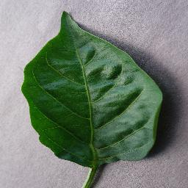
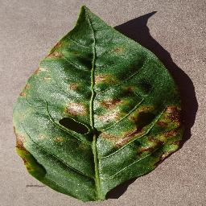
Plant Disease Detection Using CNN
Sedef Yılmaz - 61720212
Software Engineering BSc.

Slide 2
Research Questions
• Can we classify plant diseases accurately?
• How effective is CNN on this dataset?
• Can data augmentation improve performance?

Slide 3
Dataset Overview
Bullet points: • Can CNN classify plant diseases accurately? • Does data augmentation improve model performance? • How does the model perform on real test images?
Dataset summary: • Total images: 26934 • Classes: 11 plant disease categories + healthy • Image size standardized to 224x224 pixels

Slide 4
Workflow
Dataset Loading and Preprocessing
Data Augmentation
CNN Model Training
Model Evaluation and Validation
Prediction on Test Images

Slide 5
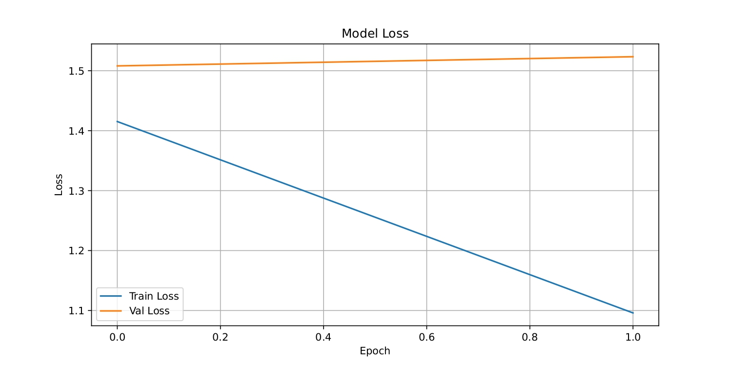
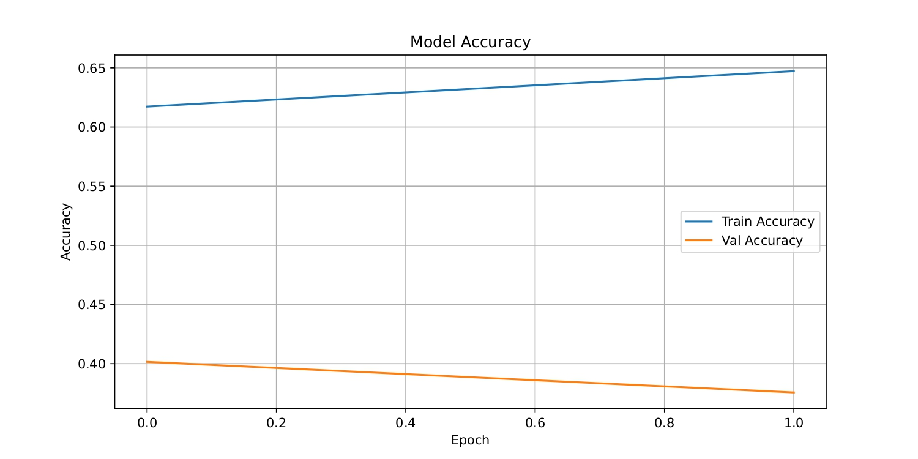
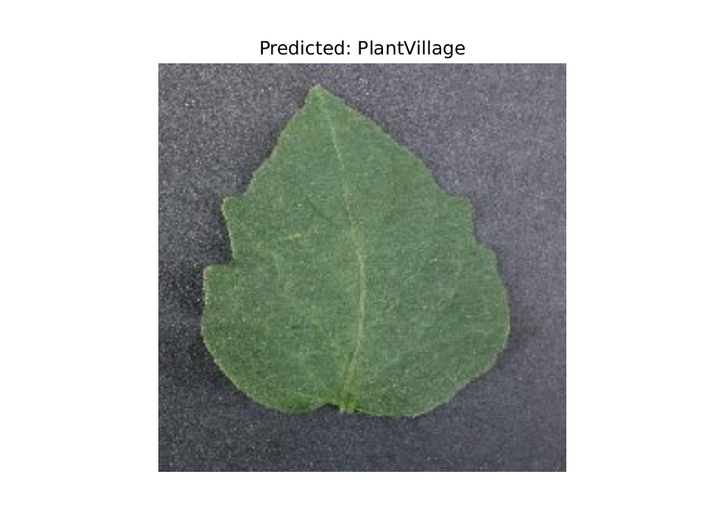
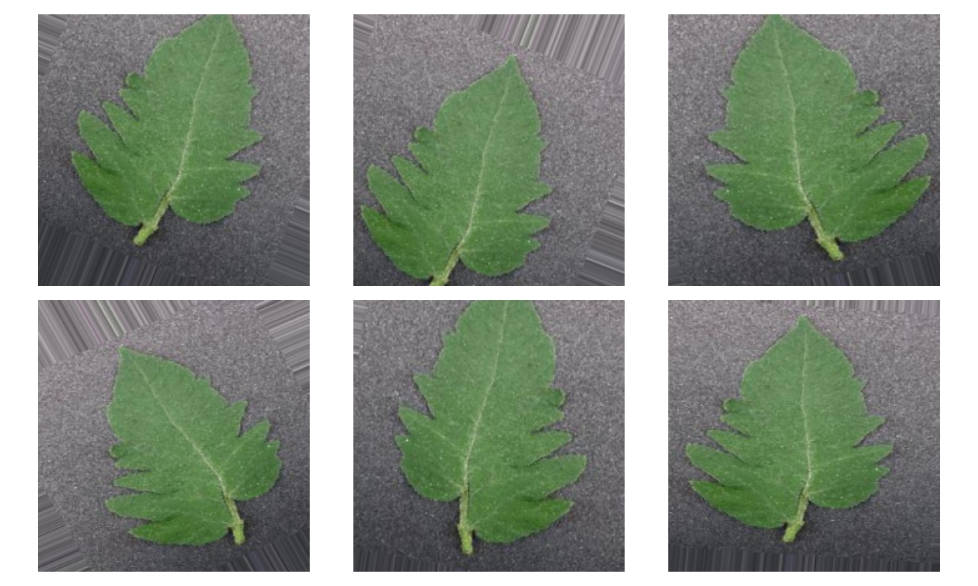
Training Results & Sample Prediction

Slide 6
Conclusion & Next Steps
• CNN effectively classifies plant diseases in this dataset
• Data augmentation improved accuracy
• Future work: deeper networks, more training, transfer learning

